Slide 1


Student Details
Name: Mayank ji rao aher
Email id: jimayank878@gmail.com
College name: Institute of technical education and Research, Bhubaneshwar
College State: ODISHA
INTERNSHIP DOMAIN: ARTIFICIAL INTELLIGENCE
START AND END DATE: 12/06/2023 – 24/07/2023

Slide 2
PROJECT TITLE/Problem Statement
Mental health is a major issue in many countries, and there is a need for better tools to help people track their mental health and identify signs of distress. To address this growing concern, there is a need for a comprehensive mental fitness tracker.
Without a reliable system in place to monitor mental fitness, it becomes challenging to identify and address mental health issues promptly, allocate appropriate resources, and design targeted interventions to support those in need.
Insufficient data integration from diverse sources creates an inaccurate analysis and insight leading to ineffective and limited comparison and evaluation thereby giving a lower precision result.
Therefore, Mental Fitness Tracker aims to develop and implement a model to accurately track the mental health of individuals based on indicators at a country level.

Slide 3
AGENDA
Overview of the project
End users / Target audience of the project
Solution to the problem statement
Differentiating factors of the project
Modelling methodologies applied to obtain the results
Visualization of the outcomes
Final outcome of the project

Slide 4
PROJECT OVERVIEW
Recognizing the importance of mental health fitness, this project intends to provide valuable insights, support evidence-based decision-making, and enable targeted interventions to address mental health challenges by analyzing the data and then modeling to derive an informed decision out of it.
The scope of the Mental Fitness Tracker project includes the development of a tracker that will collect data on mental fitness such as sleep patterns, heart rate, stress levels, existing prevalent disorders, and other relevant disorders being scalable to evaluate at a larger population level.
The purpose of the Mental Fitness Tracker is to improve mental health outcomes by providing accurate data on mental well-being indicators, thereby enabling informed decision-making based on the data provided. Also, it raises awareness in the population and promotes mental fitness tracking.
The objectives of the Mental Fitness Tracker include generating insights and reports on mental fitness trends and patterns to support evidence-based decision-making, sharing of data, and interoperability, working on a country level and promoting awareness among the population about mental health and its importance, and proactively tracking it too.

Slide 5
WHO ARE THE END USERS of this project?
The project is capable of benefitting a wide range of population, segregating them into various categories:
People – The primary users are the individuals of the population who can use the tracker to track their mental health and take decisions and manage their mental illness.
Health Professionals – Psychiatrists, Psychologists, counselors, and therapists can use the data, gain insights and make treatment plans, providing them with an understanding of their client’s mental health.
Policy makers and government agencies – Based on the data generated by the Mental Fitness Tracker, they can make informed decisions and suitable policies, resource allocation, and develop trends at a population level.
Researchers and academics – They can leverage the anonymized and aggregated data from the project to conduct studies, analyze trends, and contribute to the advancement of knowledge in research.
Non-profit organizations and advocacy groups – They focus on mental health and use the insights and reports from the project to support their efforts and awareness and design programs and campaigns that address specific mental health needs within the population.
Employers and Human Resources – They can collaborate with the data from the project to promote employee well-being, monitor stress levels, and provide targeted support.

Slide 6
YOUR SOLUTION AND ITS VALUE PROPOSITION
The solution to the above problem statement lies in building a comprehensive model – Mental Fitness Tracker, that tracks the mental health of people at a country level by analyzing the data such as sleep patterns, heart rate, prevalent existing disorders such as schizophrenia, bipolar disorders, anxiety, etc., from various countries by merging the data from all countries.
Value Proposition
Awareness among people – People will be aware of their mental well-being, thereby necessary action as and when required and also preventing any undesired consequences with timely intervention.
Improved health systems – With better decision-making capacity based on the accurate results from the model, we can implement improved health systems and services.
Research and knowledge advancement – The data obtained from diverse regions can be used by researchers to conduct studies, analyze trends and develop a holistic approach to mental health problems.
Targeted interventions – With the help of results from the model, the tracker enables the identification of individuals in need of supervision, thereby providing personalized treatments and help.

Slide 7
How did you customize the project and make it your own
The existing model provided for the problem statement was focused on data pre-processing, visualization of data, and modeling the data through the algorithms, linear regression model, and random forest regressor. The results obtained from both algorithms were evaluated and it was concluded that the random forest regressor gives a more accurate result.
While customizing the project, I went through a series of steps, such as merging the data sets, cleaning and transforming the dataset, performing exploratory data analysis, and visualizing the correlations in the dataset by various plots such as a heatmap, pair plots, and pie charts. In addition to these visualizations described in the project, I have included a joint plot of the various causes of unwell mental health and mental fitness that showcases the relationship between different variables with mental fitness, thereby giving an indication of which factor is the most prevalent in affecting mental health.
While modeling, I have used Linear Regression and Extreme Gradient Boosting algorithms to optimize the model and get an accurate result out of it. While evaluating, the XGBoost ML model gave multiple advantages over linear regression as it can handle non-linear relationships and high-dimensional data well, as well as it can handle more complex relationships between datasets giving accurate results. Compared to the random forest regressor, the XGBoost algorithm can handle an imbalanced dataset well, as in this case, the dataset might be imbalanced as we are taking data from various countries and dealing with multiple factors too.

Slide 8
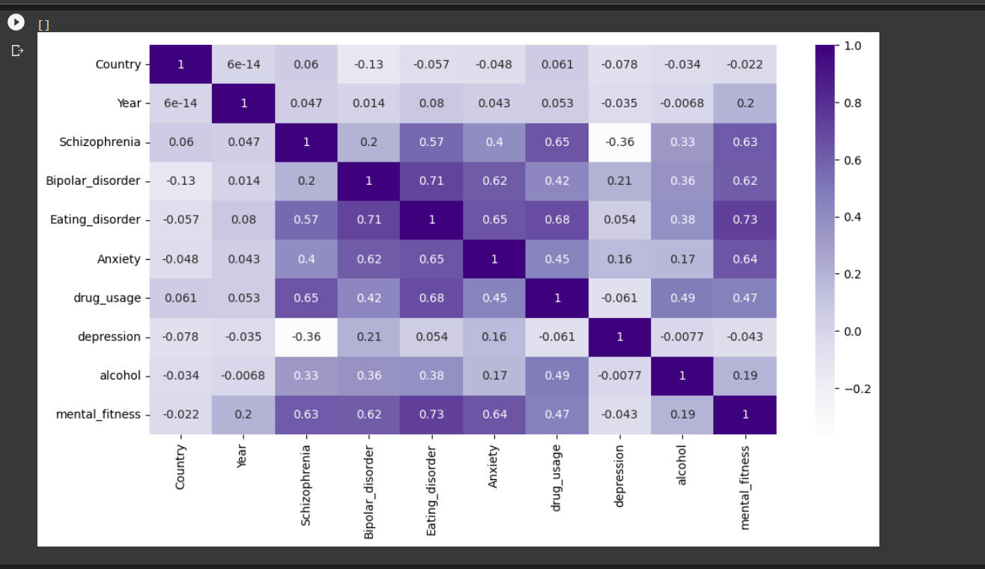
MODELLING
While modeling the dataset, I used descriptive as well as predictive analysis.
Descriptive analysis –
Plotted a heatmap that gave an idea of patterns or clusters in the dataset and correlation analysis that helped in identifying the important factors affecting mental fitness

Slide 9
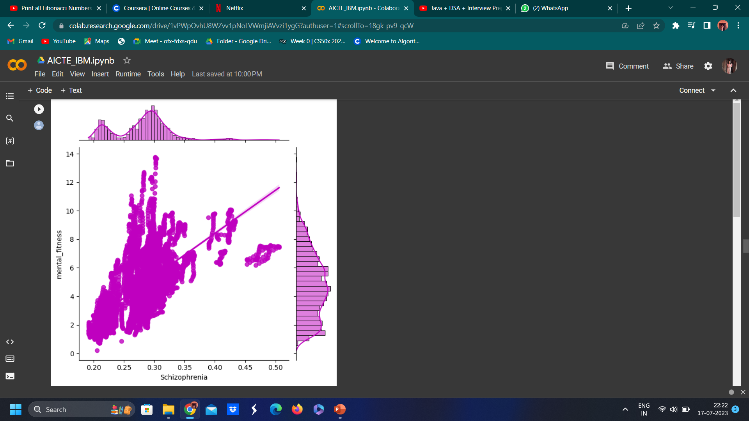
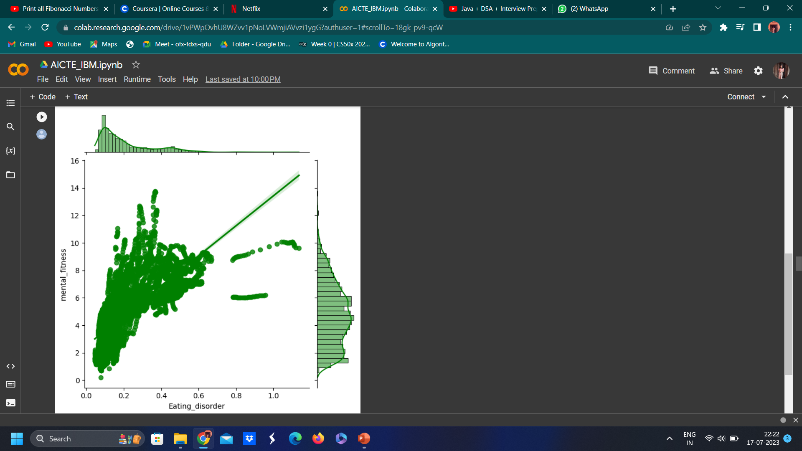
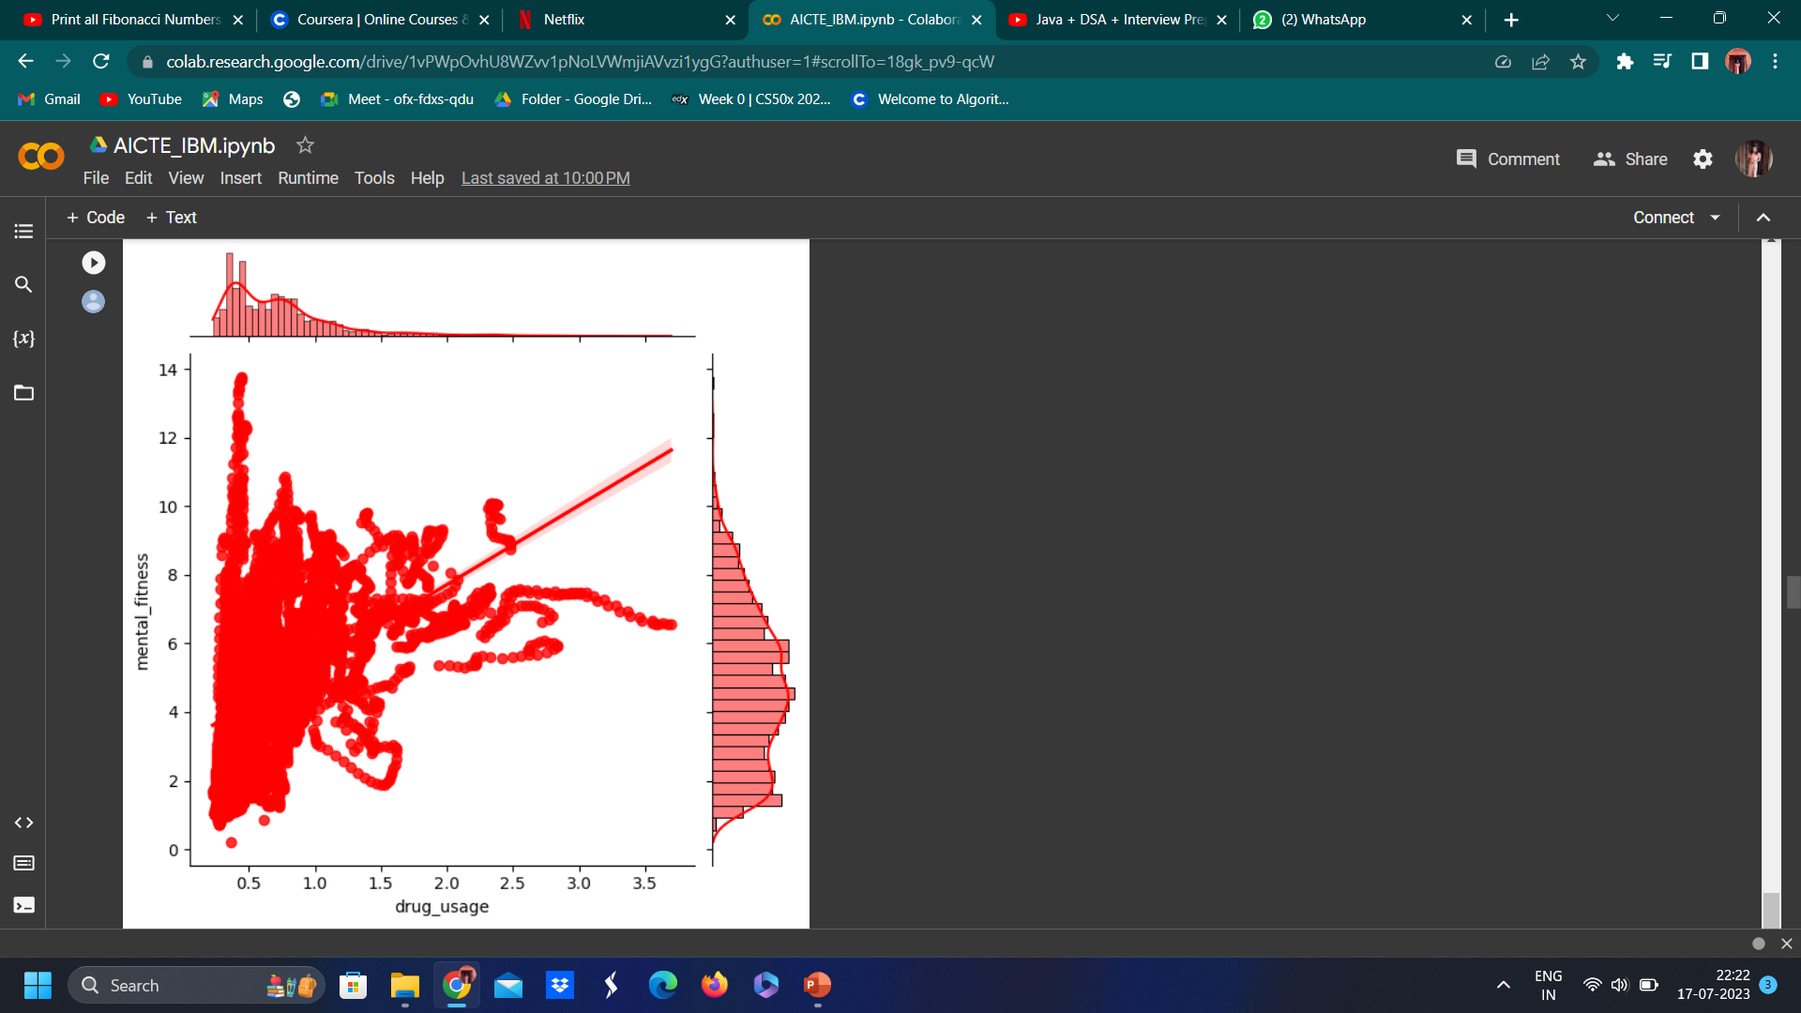
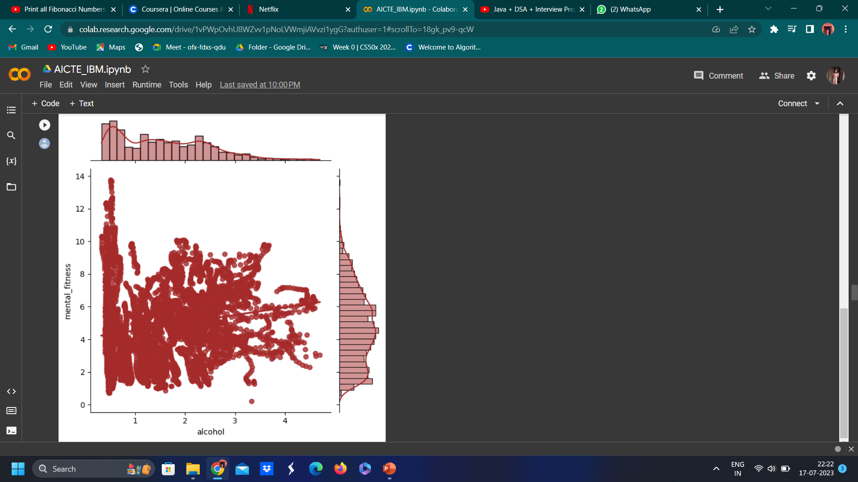
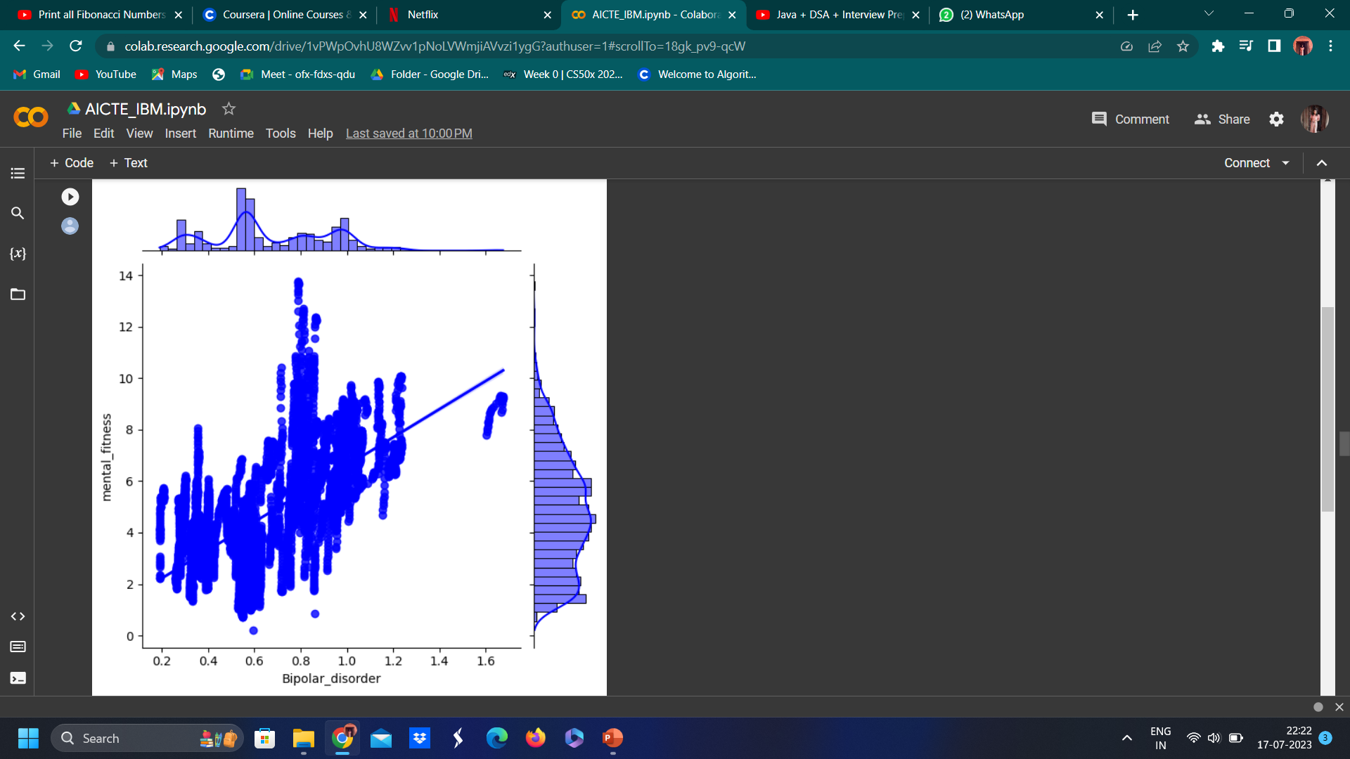
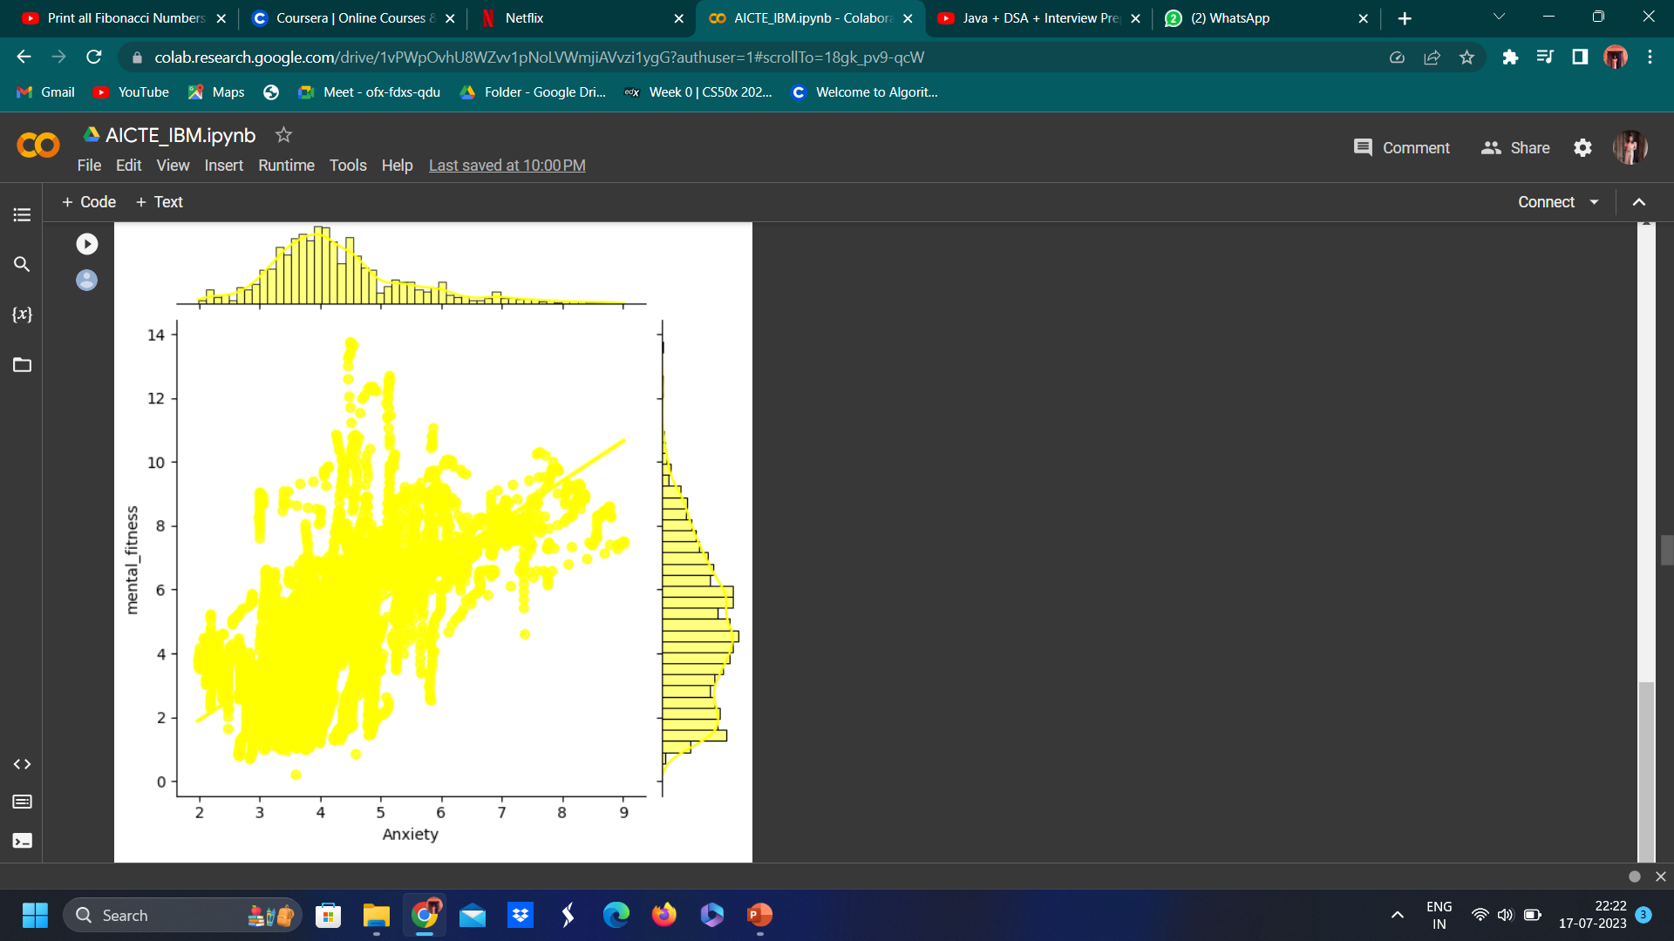
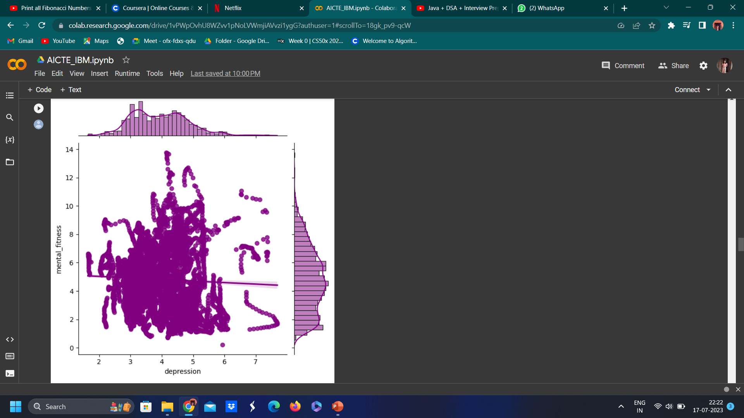
Modelling (cont’d)
Plotted a joint plot of the various factors affecting mental health with mental fitness to identify associations, visualize distributions and detect outliers within the dataset

Slide 10
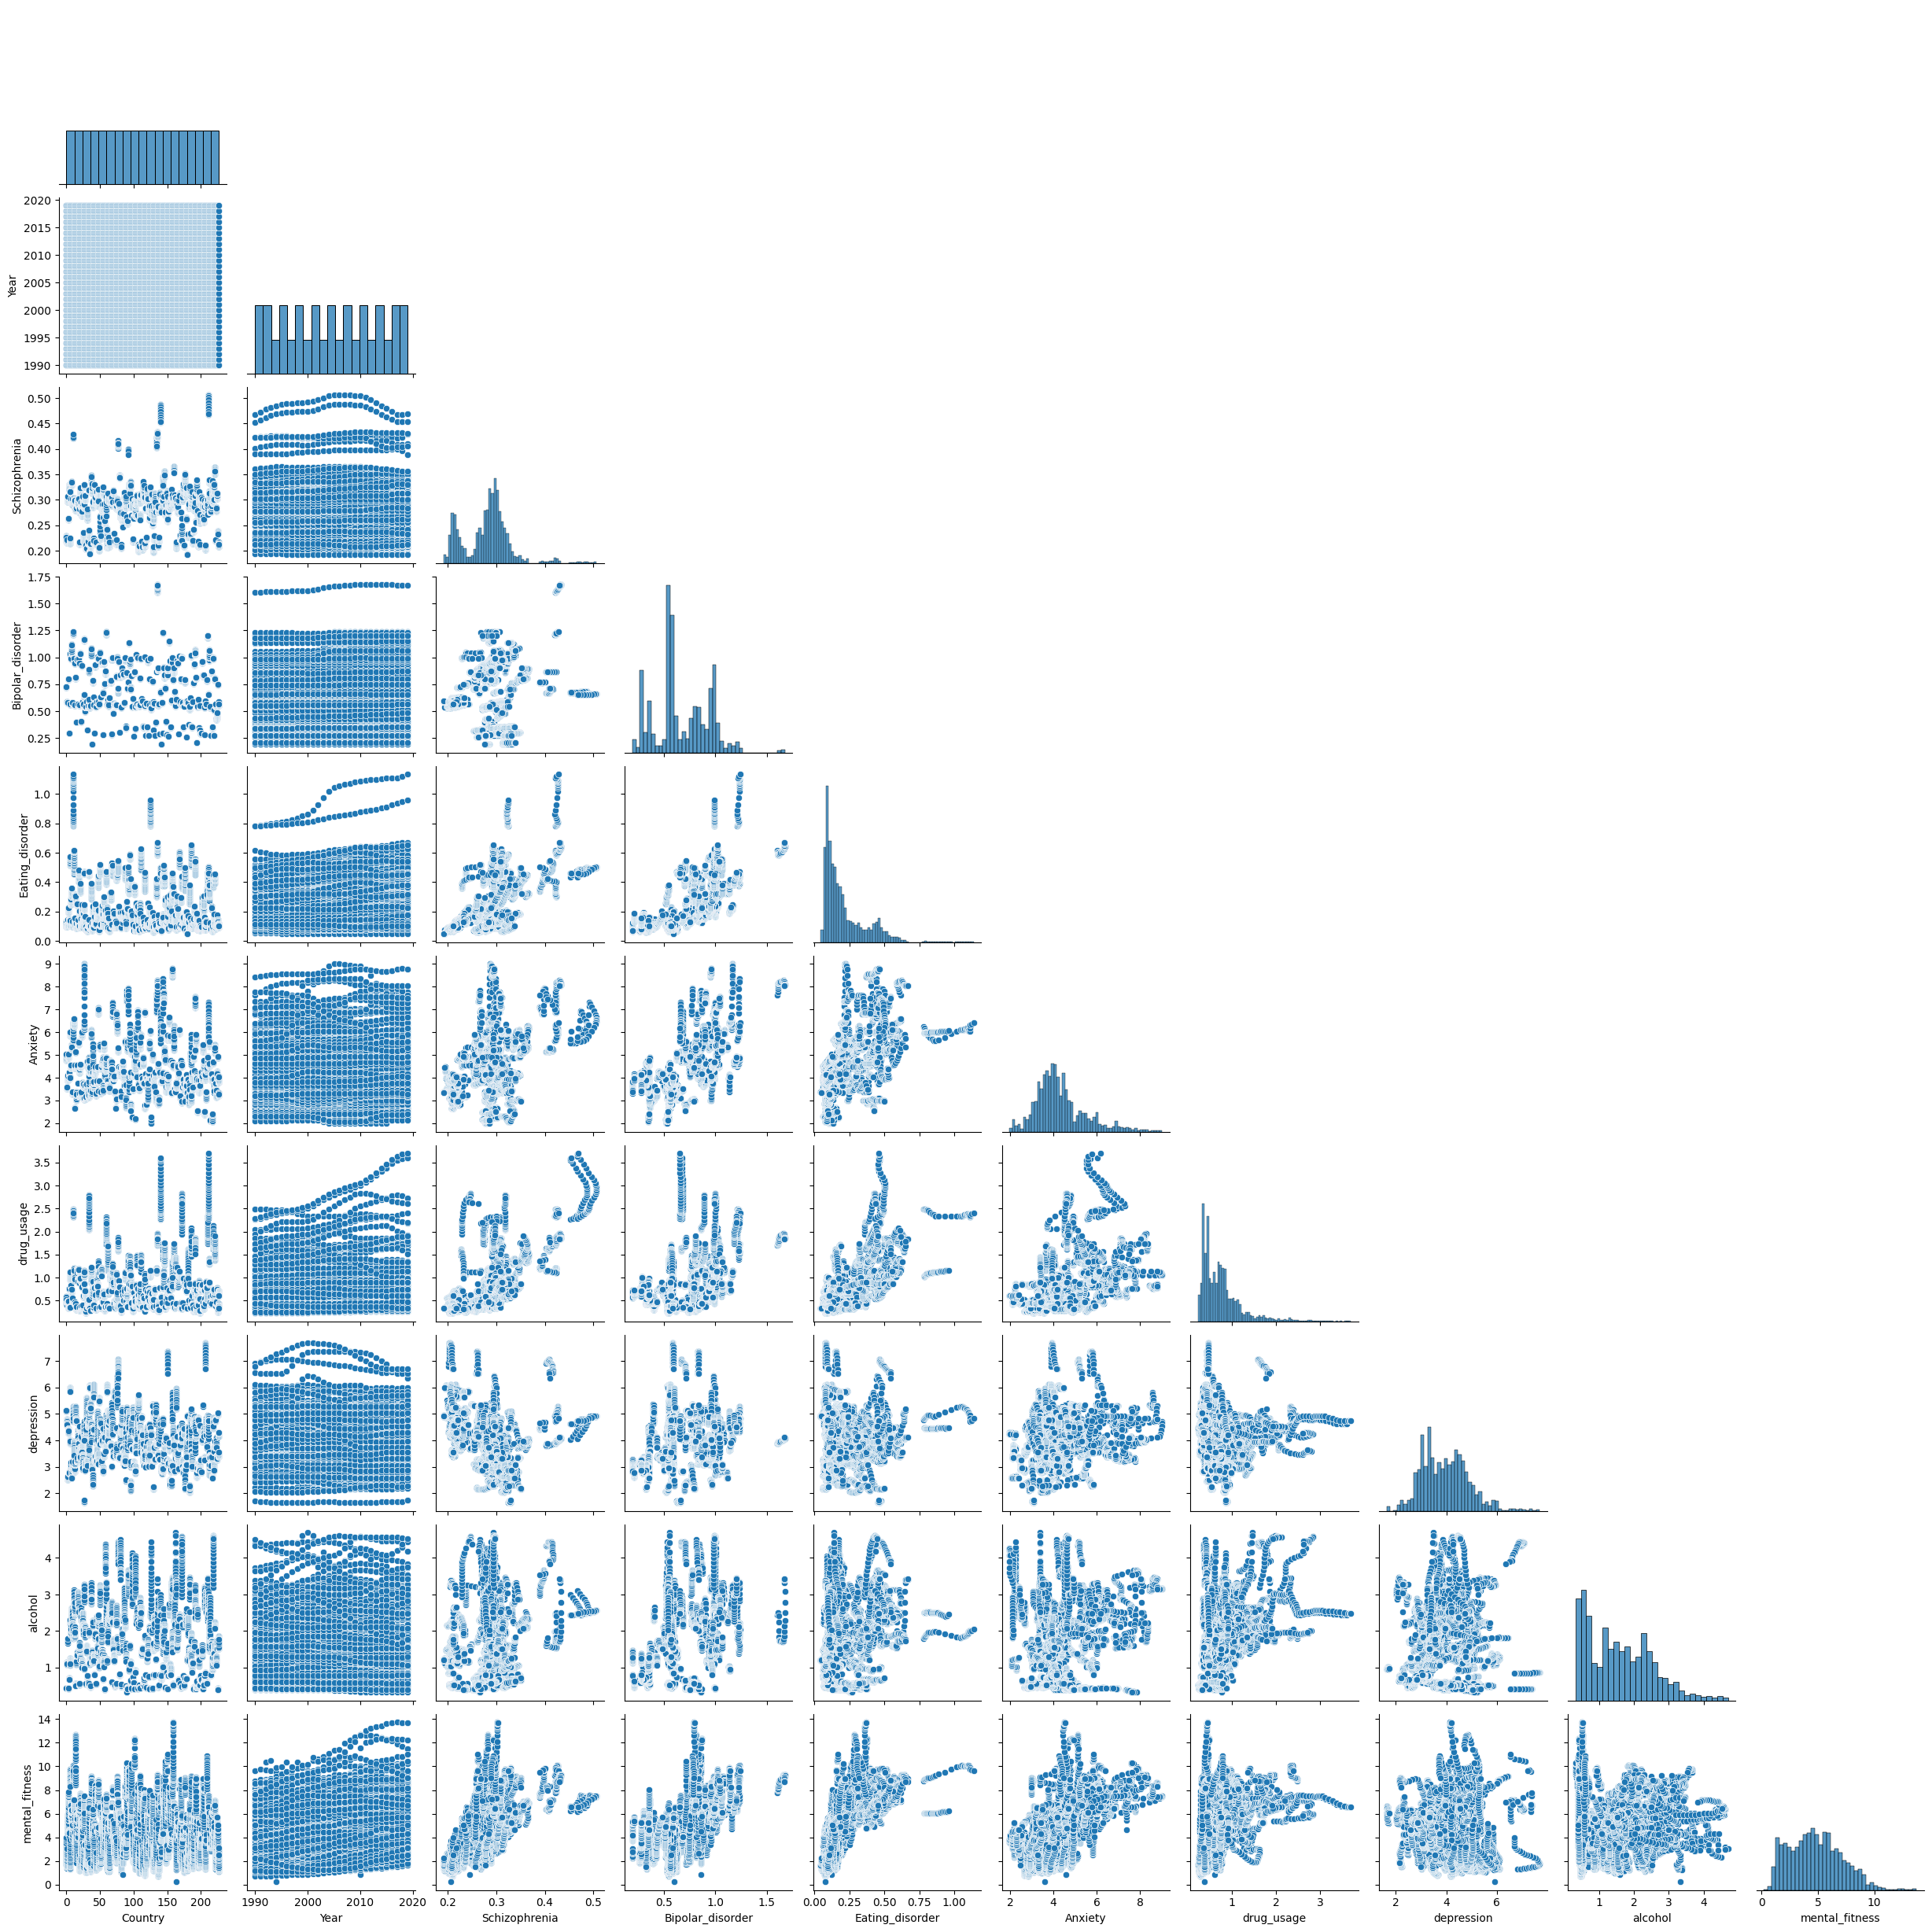
Modelling (cont’d)
Plotted a pair plot to examine pairwise relationships between multiple variables, displaying the relation of each variable individually and an insight into the multivariate relationship between causes of mental disorders and mental fitness.

Slide 11
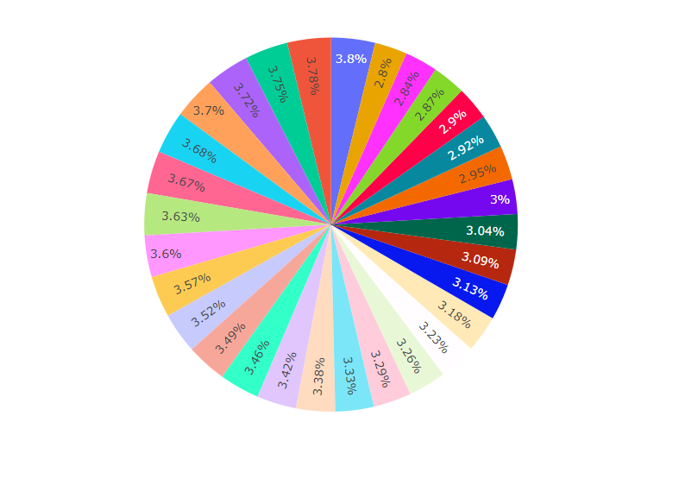
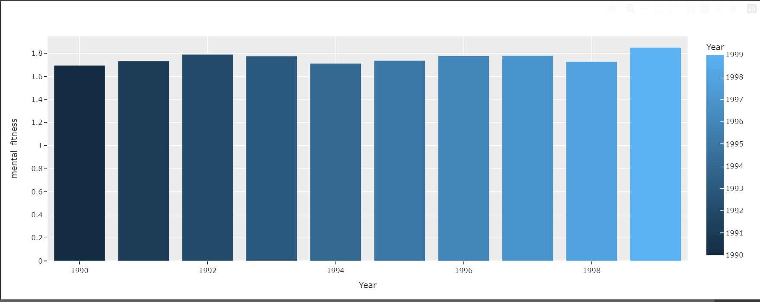
Modelling (cont’d)
Plotted a pie chart and bar chart to show the relationship between mental fitness and year.

Slide 12
Modelling (cont’d)
Next, I used predictive analysis to forecast the outcomes based on the data provided.
Firstly, I used the Linear Regression algorithm to predict the mental fitness of a country that gave an accuracy of 77%.
Because of a large amount of data and multiple features, linear regression is unable to generate optimal results.
Therefore, for more accurate and better results, I used another machine learning algorithm, Extreme Gradient Boosting (XGBoost) due to its advantages such as its high performance, ability to handle complex relationships, regularization techniques, and feature importance estimation.

Slide 13
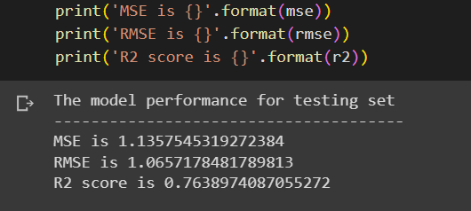
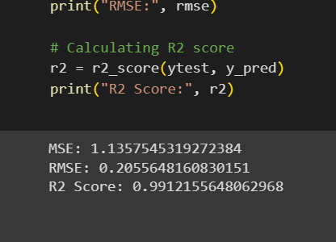
Results
On evaluating the results obtained from the two algorithms, the Linear Regression model gives an accuracy of 77% whereas the XGBoost model gives an accuracy of 99%.
Known for its exceptional performance and speed, XGBoost can handle complex relationships between feature and target variables well which is present in our dataset. It prevents overfitting by adding penalty terms to the loss function, leading to a more generalized model. Also, its feature importance metric allows us to understand the relative importance of each variable in predicting the target variable, thereby making feature selection and identification of important variables easier
Linear Regression
XGBoost

Slide 14
links
https://skillsbuild.edunetworld.com/courses/ai/mental-fitness-tracker/
https://www.sciencedirect.com/science/article/pii/S1574119217305692
https://github.com/Mayank5112/Mental_FItness-tracker-
https://colab.research.google.com/drive/1vPWpOvhU8WZvv1pNoLVWmjiAVvzi1ygG?usp=sharing
https://xgboost.readthedocs.io/en/stable/

